Slide 1

STABILITY AND STABILIZATION OF NETWORKED LOAD FREQUENCY CONTROL SYSTEMS INTEGRATED WITH ELECTRIC VEHICLE AGGREGATORS.
Presented By:
Sharini Rithigaa B S (17CE153).
Gokulnath M (17EE111).
Kalavagunta Vamshi (17EE118).
Kalla Anil Sai Kumar (17EE119).
Under the guidance of, Dr. K.Ramakrishnan, M.E., Ph.D.,
Associate Professor,
Department of EEE.

Slide 2
LITERATURE SURVEY:
This project deals with computation of communication time delays on stability regions and stability delay margins of the PI controller between the Electric Vehicle Aggregator and the smart grid of a single area load frequency control(LFC) system.
A graphical method of characterizing stability boundary locus is implemented.
For a given time delay, the method computes all the stability gains of PI controller, which constitutes a stability regions in parameters of space of PI controller.
Later a frequency domain exact method is used to calculate stability delay margins for various values of PI controller gains.
The complete analysis is made in order to pass the information of error in the system within the stability margin delay to bring the system to equilibrium point.

Slide 3
OBJECTIVES OF PROJECT:
To access the impact of integrating electrical vehicle aggregator on stability of single area load frequency control system.
The integration of geographically dispersed electric vehicle aggregator through communication network introduces time delay in closed loop control system.
The presence of time delay in feedback loop of the closed loop load frequency control system affects performance and stability of the system.
In this presentation, a methodology is presented to assess the maximum allowable bound of time delay within which the networked load frequency control system stays stable.

Slide 4
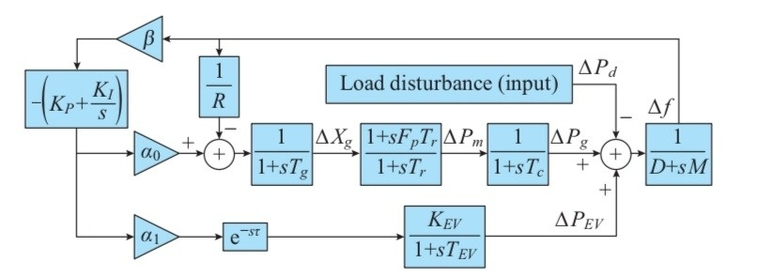
LFC SYSTEM MODEL WITH EV AGGREGATOR:
Fig. 1. System model of single-area LFC with EV aggregator.

Slide 5
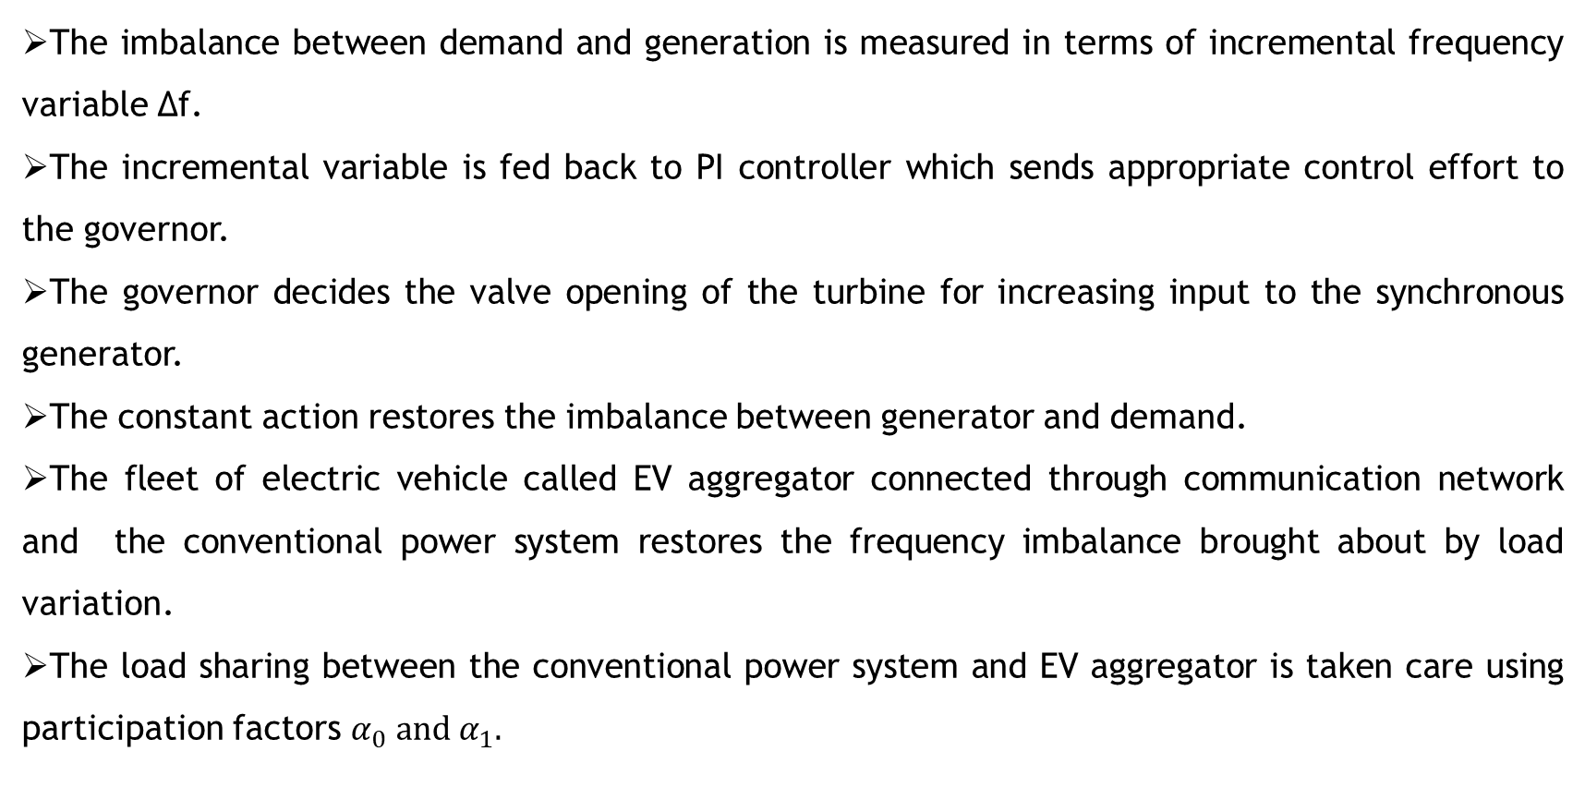
SYSTEM DESCRIPTION:
The imbalance between demand and generation is measured in terms of incremental frequency variable ∆f.
The incremental variable is fed back to PI controller which sends appropriate control effort to the governor.
The governor decides the valve opening of the turbine for increasing input to the synchronous generator.
The constant action restores the imbalance between generator and demand.
The fleet of electric vehicle called EV aggregator connected through communication network and the conventional power system restores the frequency imbalance brought about by load variation.
The load sharing between the conventional power system and EV aggregator is taken care using participation factors $α_{0} and α_{1}.$

Slide 6
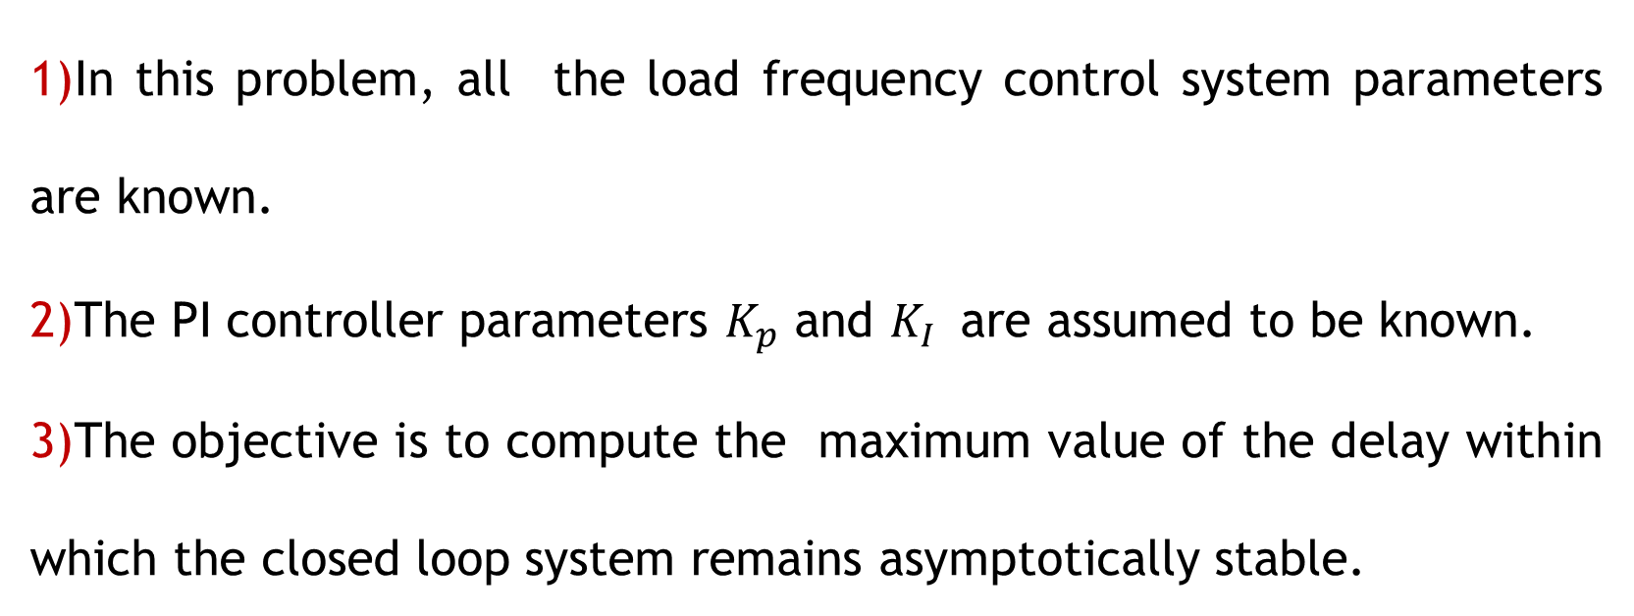
DELAY-DEPENDENT STABILITY PROBLEM:
In this problem, all the load frequency control system parameters are known.
The PI controller parameters $K_{p}$ and $K_{I }$ are assumed to be known.
The objective is to compute the maximum value of the delay within which the closed loop system remains asymptotically stable.

Slide 7
DELAY DEPENDANT STABILITY MARGIN:
$τ^{∗}$ - STABILITY DELAY MARGIN (s)
K_{p} | K_{I}=0.2 | K_{I}=0.4 | K_{I}=0.6 | K_{I}=0.8 | K_{I}=1.0
0 | 1.7866 | 0.4231 | 0.0859 | -0.0615 | -0.1417
0.1 | 2.7421 | 0.8271 | 0.3496 | 0.1340 | 0.0134
0.2 | 3.5861 | 1.2002 | 0.6018 | 0.3242 | 0.1656
0.3 | 4.2522 | 1.5214 | 0.8327 | 0.5034 | 0.3115
0.4 | 4.6970 | 1.7773 | 1.0346 | 0.6669 | 0.4477
0.5 | 4.8537 | 1.9635 | 1.2023 | 0.8108 | 0.5717
0.6 | 4.6817 | 2.0829 | 1.3339 | 0.9327 | 0.6812
0.7 | 4.3135 | 2.1433 | 1.4300 | 1.0317 | 0.7751
0.8 | 3.9050 | 2.1545 | 1.4932 | 1.1080 | 0.8527
0.9 | 3.5197 | 2.1273 | 1.5275 | 1.1628 | 0.9142
1.0 | 3.1740 | 2.0715 | 1.5372 | 1.1982 | 0.9606

Slide 8
COMPUTATION OF STABILITY DELAY MARGINS:
In last phase, for various values of the proportional gain constant K_{p} and integral gain constant K_{I}, the stability time delay margin was validated while keeping K_{p} and K_{I} values as constant in each individual case(for different sets of K_{p} and K_{I} values).
In this phase, by keeping time delay as constant, and for various values of time delay, we determine the values of K_{p} and K_{I} at which the system lies stable.
Also, the impact of EV aggregator participation factor α₁ and the communication time delay τ on the stability region is investigated.

Slide 9
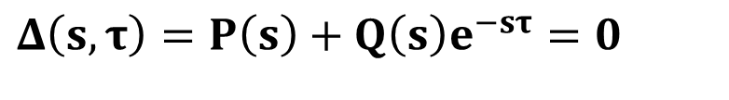
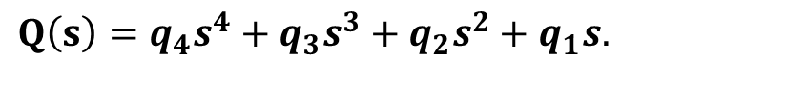
COMPUTATION OF STABILITY REGIONS:
For stability analysis, the characteristic equation given below of LFC system with time delay is required.
$$Δ\left(s,τ\right)=P\left(s\right)+Q\left(s\right)e^{−sτ}=0$$
(1)
Where,
$$P\left(s\right)=p_{6}s^{6}+p_{5}s^{5}+p_{4}s^{4}+p_{3}s^{3}+p_{2}s^{2}+p_{1}s.$$
$$Q\left(s\right)=q_{4}s^{4}+q_{3}s^{3}+q_{2}s^{2}+q_{1}s.$$

Slide 10
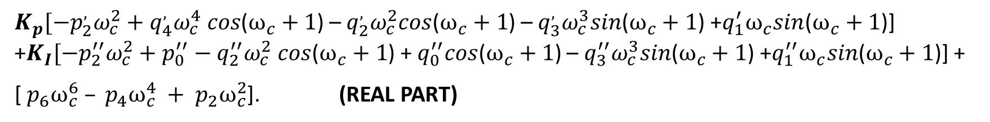
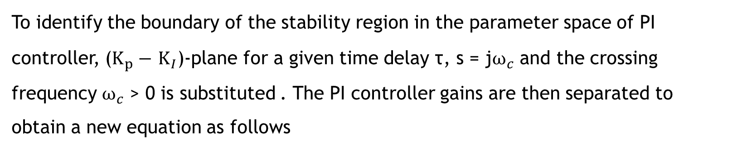
COMPUTATION OF STABILITY REGIONS:
To identify the boundary of the stability region in the parameter space of PI controller, ($K_{p}−$$K_{I}$)-plane for a given time delay τ, s = j$ω_{c}$ and the crossing frequency $ω_{c}$> 0 is substituted . The PI controller gains are then separated to obtain a new equation as follows
$K_{p}[−p_{2}^{,}ω_{c}^{2}+q_{4}^{,}ω_{c}^{4} cos$($ω_{c}+1$) – $q_{2}^{,}ω_{c}^{2}cos$($ω_{c}+1$) – $q_{3}^{,}ω_{c}^{3}sin$($ω_{c}+1$) +$q_{1}^{′}ω_{c}sin$($ω_{c}+1$)] +$K_{I}[−p_{2}^{′′}ω_{c}^{2}+p_{0}^{′′}−q_{2}^{′′}ω_{c}^{2} cos$($ω_{c}+1$) +${ q}_{0}^{′′}cos$($ω_{c}+1$) – $q_{3}^{′′}ω_{c}^{3}sin$($ω_{c}+1$) +$q_{1}^{′′}ω_{c}sin$($ω_{c}+1$)] +
[ $p_{6}ω_{c}^{6}$$– p_{4}ω_{c}^{4} ­­+ p_{2}ω_{c}^{2}$]. (REAL PART)
$K_{p}A_{1}\left(ω_{c}\right)+K_{I}B_{1}\left(ω_{c}\right)$ = -$C_{1}\left(ω_{c}\right)$

Slide 11
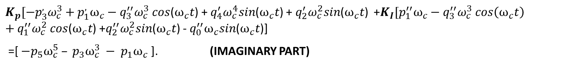
$K_{p}$A₁($ω_{c}$)+ $K_{I}$B₁($ω_{c}$)+ C₁ ($ω_{c}$) = 0 -----(2)
$K_{p}[−p_{3}^{,}ω_{c}^{3}+p_{1}^{,}ω_{c}−q_{3}^{′′}ω_{c}^{3} cos$($ω_{c}t$) + $q_{4}^{′}ω_{c}^{4}sin$($ω_{c}t$) + $q_{2}^{′}ω_{c}^{2}sin$($ω_{c}t$) +$K_{I}[p_{1}^{′′}ω_{c}−q_{3}^{′′}ω_{c}^{3} cos\left(ω_{c}t\right)+q_{1}^{′′}ω_{c}^{2} cos$($ω_{c}t$) +$q_{2}^{′′}ω_{c}^{2}sin$($ω_{c}t$) - $q_{0}^{′′}ω_{c}sin$($ω_{c}t$)]
=[ ${−p}_{5}ω_{c}^{5}$$– p_{3}ω_{c}^{3} ­­− p_{1}ω_{c}$ ]. (IMAGINARY PART)
$K_{p}A_{2}\left(ω_{c}\right)+K_{I}B_{2}\left(ω_{c}\right)$ = -$C_{2}\left(ω_{c}\right)$
$K_{p}$A₂($ω_{c}$)+ $K_{I}$B₂($ω_{c}$)+ C₂ ($ω_{c}$) = 0 -----(3)

Slide 12
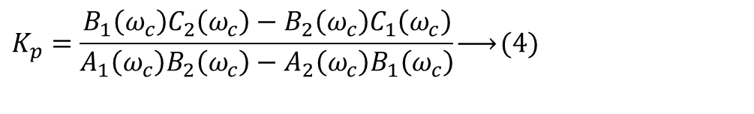

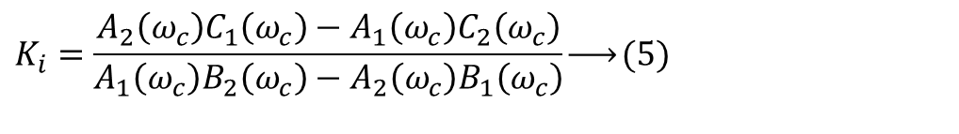
COMPUTATION OF STABILITY REGIONS:
$$e^{−sτ}=e^{−jωτ}=\cos\left(ωτ\right)−j\sin\left(ωτ\right),$$
In Equation (1) substituting
On solving, We get,
$$K_{p}=\frac{B_{1}\left(ω_{c}\right)C_{2}\left(ω_{c}\right)−B_{2}\left(ω_{c}\right)C_{1}\left(ω_{c}\right)}{A_{1}\left(ω_{c}\right)B_{2}\left(ω_{c}\right)−A_{2}\left(ω_{c}\right)B_{1}\left(ω_{c}\right)}\underset{→}{ }(4)$$
$$K$$
$$K_{i}=\frac{A_{2}\left(ω_{c}\right)C_{1}\left(ω_{c}\right)−A_{1}\left(ω_{c}\right)C_{2}\left(ω_{c}\right)}{A_{1}\left(ω_{c}\right)B_{2}\left(ω_{c}\right)−A_{2}\left(ω_{c}\right)B_{1}\left(ω_{c}\right)}\underset{→}{ }(5)$$
Where, A1,B1,C1,A2,B2,C2 are coefficients.

Slide 13
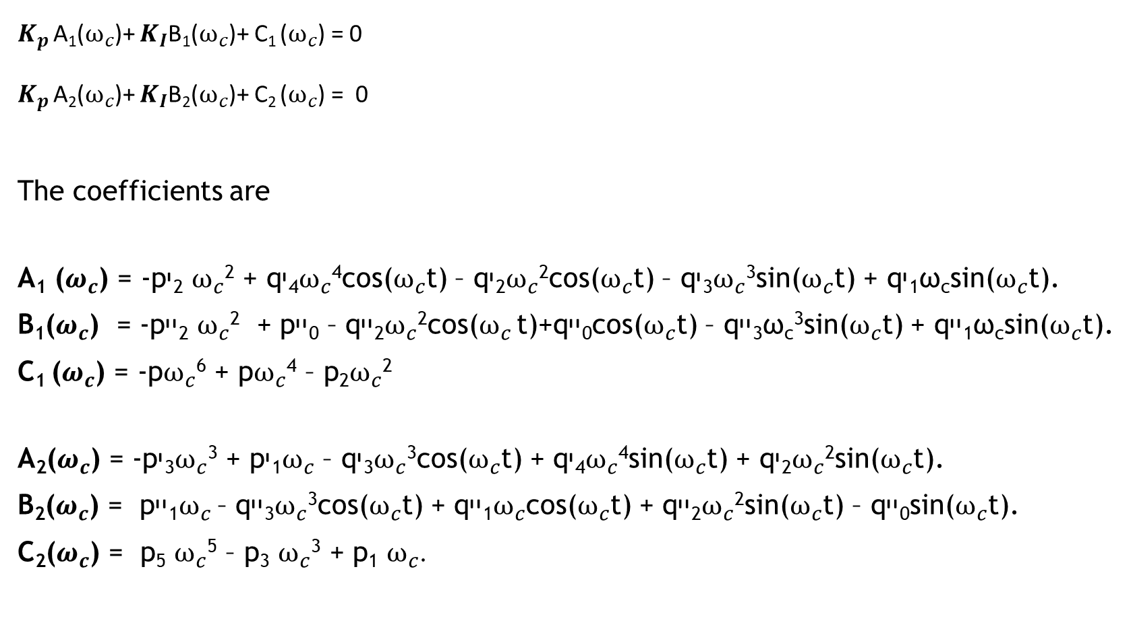
$K_{p}$A₁($ω_{c}$)+ $K_{I}$B₁($ω_{c}$)+ C₁ ($ω_{c}$) = 0
$K_{p}$A₂($ω_{c}$)+ $K_{I}$B₂($ω_{c}$)+ C₂ ($ω_{c}$) = 0
The coefficients are
A₁ ($ω_{c}$) = -pי₂$ω_{c}$² + qי₄$ω_{c}$⁴cos($ω_{c}$t) – qי₂$ω_{c}$²cos($ω_{c}$t) – qי₃$ω_{c}$³sin($ω_{c}$t) + qי₁ω_{c}sin($ω_{c}$t).
B₁($ω_{c}$) = -pיי₂$ω_{c}$² + pיי₀ – qיי₂$ω_{c}$²cos($ω_{c}$t)+qיי₀cos($ω_{c}$t) – qיי₃ω_{c}³sin($ω_{c}$t) + qיי₁ω_{c}sin($ω_{c}$t).
C₁ ($ω_{c}$) = -p$ω_{c}$⁶ + p$ω_{c}$⁴ – p₂$ω_{c}$²
A₂($ω_{c}$) = -pי₃$ω_{c}$³ + pי₁$ω_{c}$ – qי₃$ω_{c}$³cos($ω_{c}$t) + qי₄$ω_{c}$⁴sin($ω_{c}$t) + qי₂$ω_{c}$²sin($ω_{c}$t).
B₂($ω_{c}$) = pיי₁$ω_{c}$– qיי₃$ω_{c}$³cos($ω_{c}$t) + qיי₁$ω_{c}$cos($ω_{c}$t) + qיי₂$ω_{c}$²sin($ω_{c}$t) – qיי₀sin($ω_{c}$t).
C₂($ω_{c}$) = p₅$ω_{c}$⁵ – p₃$ω_{c}$³ + p₁$ω_{c}$.

Slide 14
MATLAB CODE FOR COMPUTATION OF STABILITY REGIONS:
Clear all
M=8.8;
D=1;
Tg=0.2;
Tc=0.3;
Tr=12;
Fp=1/6;
R=1/11;
beta=21;
Kev=1;
Tev=0.1;
alpha1=0.1;
alpha0=0.9;

Slide 15
MATLAB CODE FOR COMPUTATION OF STABILITY REGION:
Q4=Kp*[alpha1*beta*R*Kev*Tg*Tr*Tc];
Q3= Kp*[alpha1*beta*R*Kev*[Tr*Tc+Tg*Tc+Tg*Tr]];
Qq3=Ki*[alpha1*beta*R*Kev*Tg*Tr*Tc];
Q2=Kp*[alpha1*beta*R*Kev*[Tc+Tr+Tg]];
Qq2=Ki*[alpha1*beta*R*Kev*[Tr*Tc+Tc*Tg*Tc+Tg*Tr];
Qq0=Ki*[alpha1*beta*R*Kev*Ki];
Q1=Kp*[alpha1*beta*R*Kev];
Qq1=Ki*[alpha1*beta*R*Kev*[Tc+Tr+Tg]];
p6=M*R*Tg*Tr*Tc*Tev;
p5=D*R*Tg*Tc*Tr*Tev+M*R*[Tg*Tr*Tc+Tr*Tc*Tev+Tg*Tc*Tev+Tg*Tr*Tev];
p4=D*R*[Tr*Tg*Tc+Tr*Tc*Tev+Tg*Tc*Tev+Tg*Tr*Tev]+M*R*[Tr*Tc+Tg*Tc+Tg*Tr+Tc*Tev+Tr*Tev+Tg*Tev];

Slide 16
MATLAB CODE FOR COMPUTATION OF STABILITY REGION:
p3=D*R*[Tr*Tc+Tg*Tc+Tg*Tr+Tc*Tev+Tr*Tev+Tg*Tev]+M*R*[Tc+Tr+Tg+Tev]+Fp*Tr*Tev;
P3=Kp*[alpha0*beta*R*Fp*Tr*Tev];
p2=D*R*[Tc+Tr+Tg+Tev]+M*R+Fp*Tr+Tev;
P2=Ki*[alpha0*beta*R*[Tev+Fp*Tr]];
Pp2=Ki*[alpha0*beta*R*Fp*Tr*Tev];
p1=D*R+1;
P1=Kp*[alpha0*beta*R+1];
Pp1=Ki*[alpha0*beta*R*[Tev+Fp*Tr]];
Pp0=Ki*[alpha0*beta*R];
t = 0.5;
wc = 0:0.01:3.91;

Slide 17
MATLAB CODE FOR COMPUTATION OF STABILITY REGION:
for i=1:size(wc,2)
A1(:,i) = -P2*wc^2+Q4*wc^2*cos(wc*t)-Q2*wc^2*cos(wc*t)-Q3*wc^3*sin(wc*t)+Q1*wc*sin(wc*t);
B1(:,i) = -Pp2*wc^2+Pp0-Qq2*wc^2*cos(wc*t)+Qq0*cos(wc*t)-Qq3*wc^3*sin(wc*t)+Qq1*wc*sin(wc*t);
A2(:,i) = -P3*wc^3+P1*wc-Q3*wc^3*cos(wc*t)+Q4*wc^4*sin(wc*t)+Q2*wc^2*sin(wc*t);
B2(:,i) = Pp1*wc-Qq3*wc^3*cos(wc*t)+Qq1*wc*cos(wc*t)+Qq2*wc^2*sin(wc*t)-Qq0*sin(wc*t);
C1(:,i) = -p6*wc^6+p4*wc^4-p2*wc^2;
C2(:,i) = p5*wc^5-p3*wc^3+p1*wc;
Kp(:,i) = (B1(:,i)*C2(:,i)-B2(:,i)*C1(:,i))/(A1(:,i)*B2(:,i)-A2(:,i)*B1(:,i));
Ki(:,i) = (A2(:,i)*C1(:,i)-A1(:,i)*C2(:,i))/(A1(:,i)*B2(:,i)-A2(:,i)*B1(:,i));
end

Slide 18
MATLAB CODE FOR COMPUTATION OF STABILITY REGION:
end
plot(Kp,Ki)
hold on
x = 0;
y = -0.03:0.0001:0.059;
plot(y,x,'k')
grid
axis([-0.04 0.07 -0.02 0.12])
xlabel('Proportional Controller Gain K_{P}')
ylabel('Integral Controller Gain K_{I}')
title('Stability Region for \tau=0.5')

Slide 19
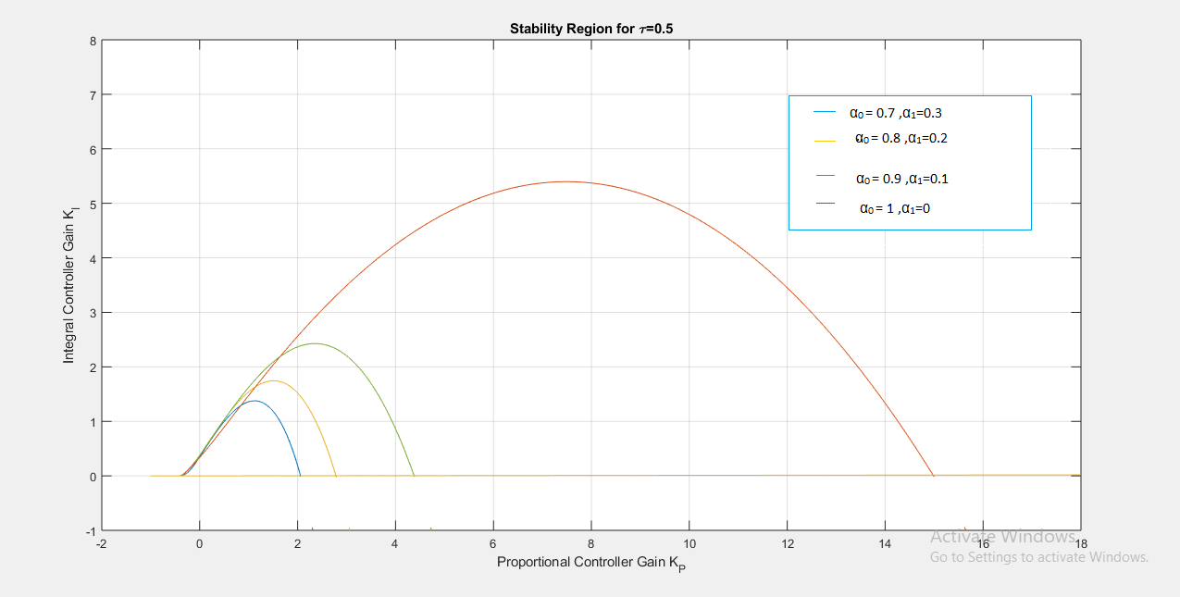
STABILITY REGION CURVE FOR TIME DELAY=0.5s FOR VARIOUS PARTICIPATION FACTORS:
Blue- α₀=0.7, α₁=0.3
Orange- α₀=0.8, α₁=0.2
Green- α₀=0.9, α₁=0.1
Brown- α₀=1.0, α₁=0

Slide 20
VALUES OF KP AND KI FOR SYSTEM STABILITY(For time delay=0.5s):
For system to be stable: The values of K_{p} and K_{I} should lie within the curve boundary for that participation factors.
Example: For α₁=0.3 and α₀=0.7 the values are K_{p} =1 and K_{I} =0.5
For system to be unstable: The values of K_{p} and K_{I} should lie anywhere out of curve boundary for that particular participation factors.
Example: For α₁=0.3 and α₀=0.7, the values are K_{p} =3 and K_{I} =2
For system to be marginally stable: The values of K_{p} and K_{I} should lie on or near to the curve boundary for that particular participation factors.
Example: For α₁=0.3 and α₀=0.7, the values are K_{p} =1.8 and K_{I} =1.4

Slide 21
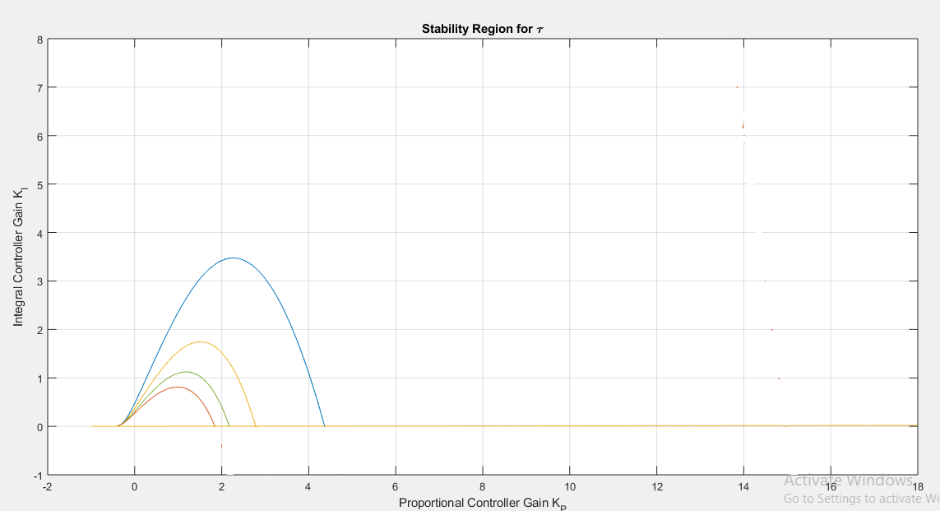
STABILITY REGION CURVE FOR TIME DELAY=0.25s FOR VARIOUS PARTICIPATION FACTORS:
Brown- α₀=0.7, α₁=0.3
Green- α₀=0.8, α₁=0.2
Orange- α₀=0.9, α₁=0.1
Blue- α₀=1.0, α₁=0

Slide 22
VALUES OF KP AND KI FOR SYSTEM STABILITY(For time delay=0.25s):
For system to be stable: The values of K_{p} and K_{I} should lie within the curve boundary for that participation factors.
Example: For α₁=0.3 and α₀=0.7 the values are K_{p} =1 and K_{I} =0.2
For system to be unstable: The values of K_{p} and K_{I} should lie anywhere out of curve boundary for that particular participation factors.
Example: For α₁=0.3 and α₀=0.7, the values are K_{p} =3 and K_{I} =2
For system to be marginally stable: The values of K_{p} and K_{I} should lie on or near to the curve boundary for that particular participation factors.
Example: For α₁=0.3 and α₀=0.7, the values are K_{p} =1.8 and K_{I} =0.1

Slide 23
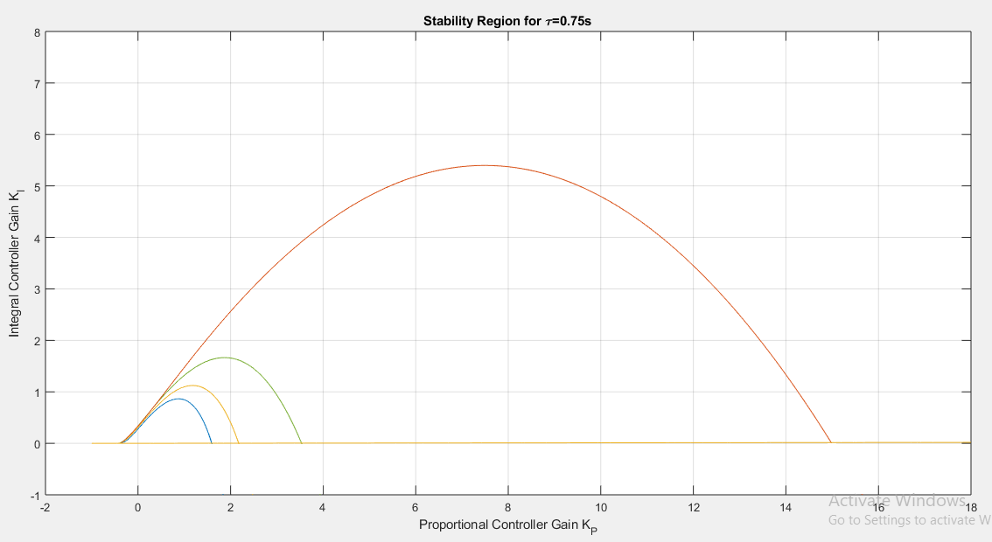
STABILITY REGION CURVE FOR TIME DELAY=0.75s FOR VARIOUS PARTICIPATION FACTORS:
Blue- α₀=0.7, α₁=0.3
Orange- α₀=0.8, α₁=0.2
Green- α₀=0.9, α₁=0.1
Brown- α₀=1.0, α₁=0

Slide 24
VALUES OF KP AND KI FOR SYSTEM STABILITY(For time delay=0.75s):
For system to be stable: The values of K_{p} and K_{I} should lie within the curve boundary for that participation factors.
Example: For α₁=0.3 and α₀=0.7 the values are K_{p} =1 and K_{I} =0.5
For system to be unstable: The values of K_{p} and K_{I} should lie anywhere out of curve boundary for that particular participation factors.
Example: For α₁=0.3 and α₀=0.7, the values are K_{p} =3 and K_{I} =2
For system to be marginally stable: The values of K_{p} and K_{I} should lie on or near to the curve boundary for that particular participation factors.
Example: For α₁=0.3 and α₀=0.7, the values are K_{p} =1.5 and K_{I} =0.1

Slide 25
SIMULATION RESULTS

Slide 26
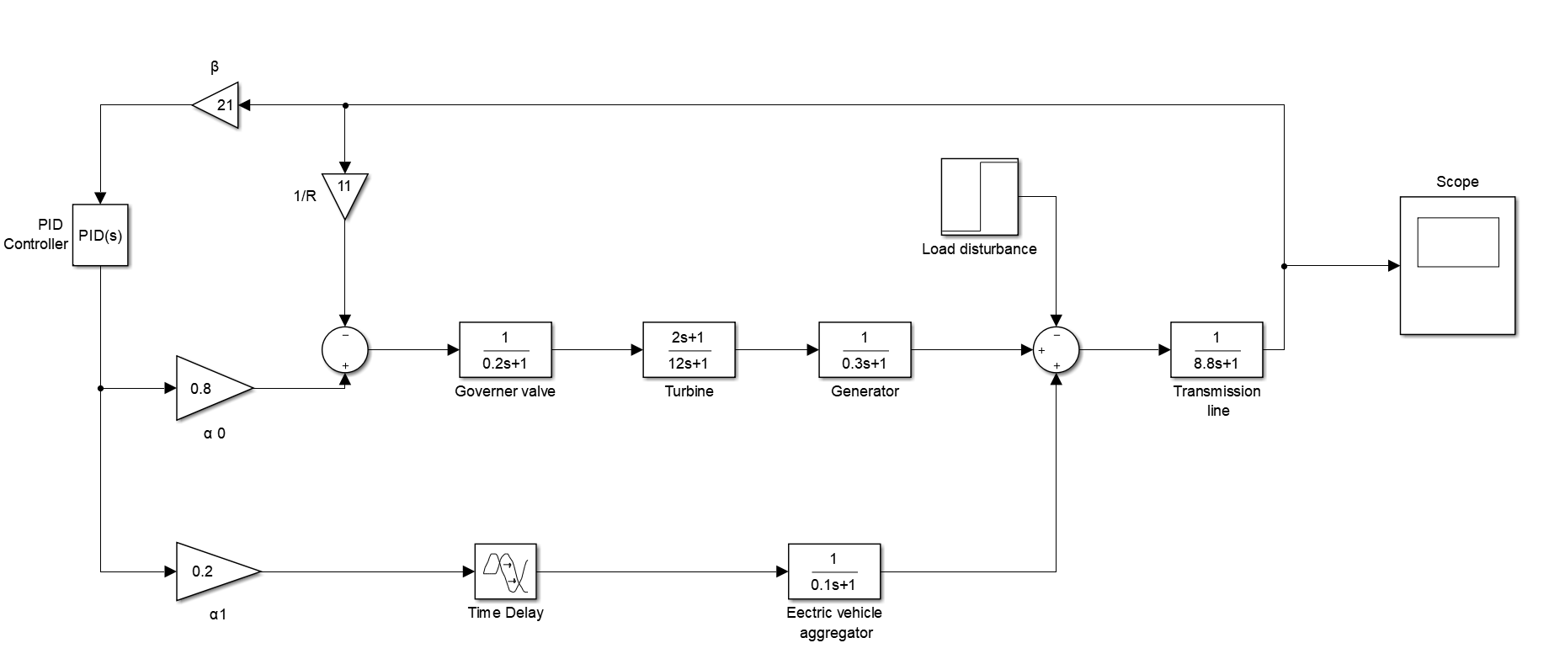
LOAD FREQUENCY CONTROL SYSTEM INTEGRATED WITH EV AGGREGATOR:

Slide 27
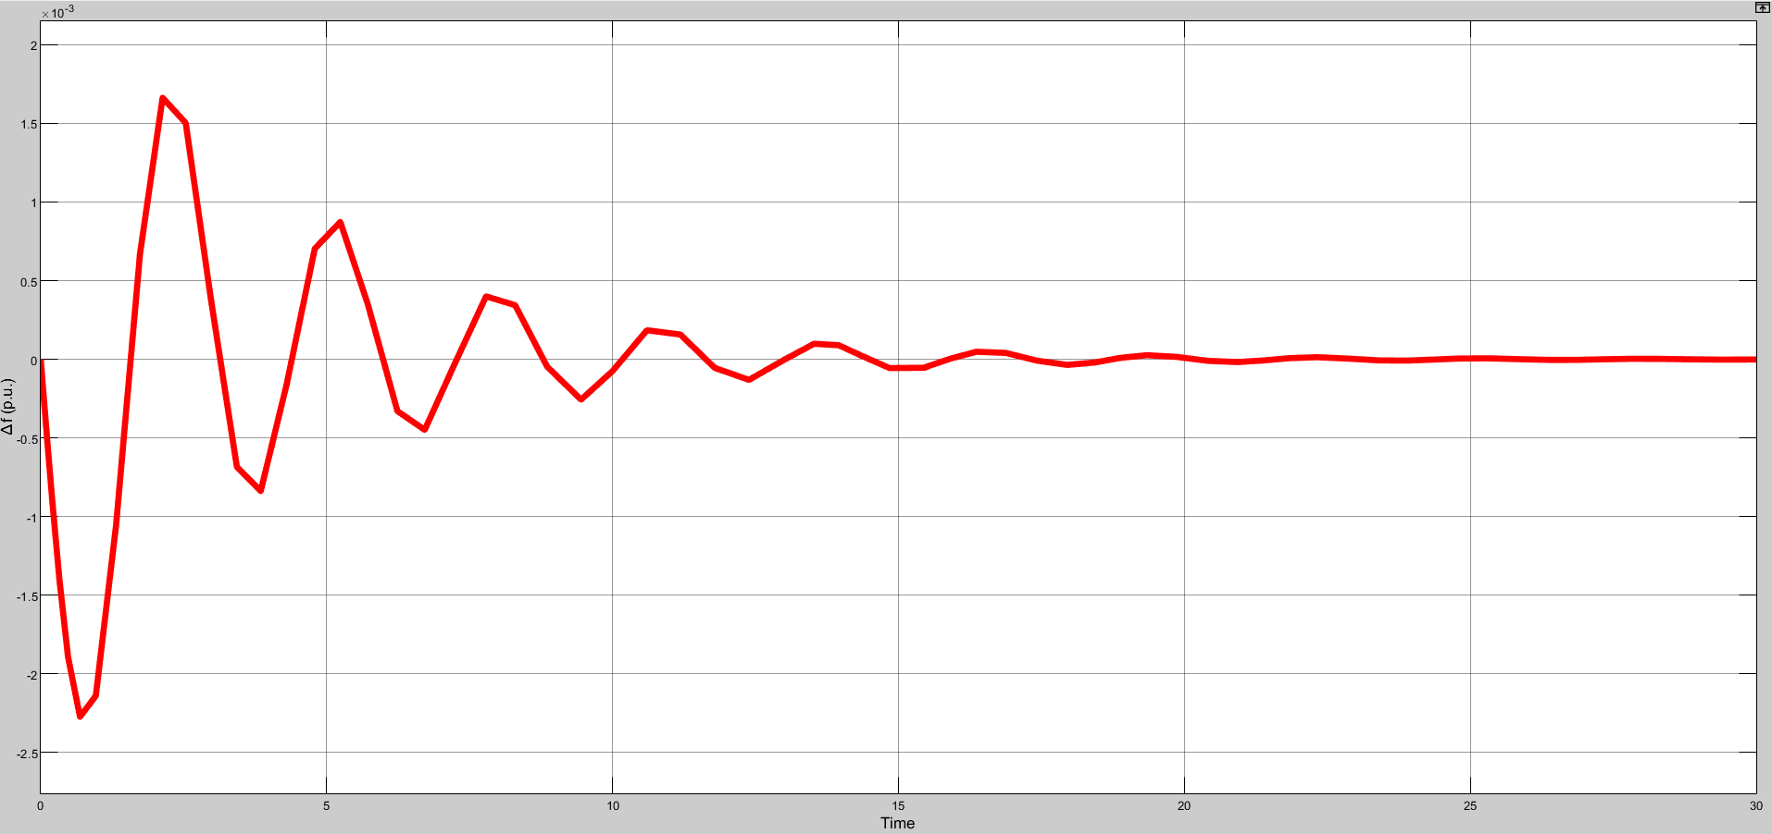
For Time delay=0.5s α₀=1 α₁=0 K_{p}=6 K_{i}=4 (stable)

Slide 28
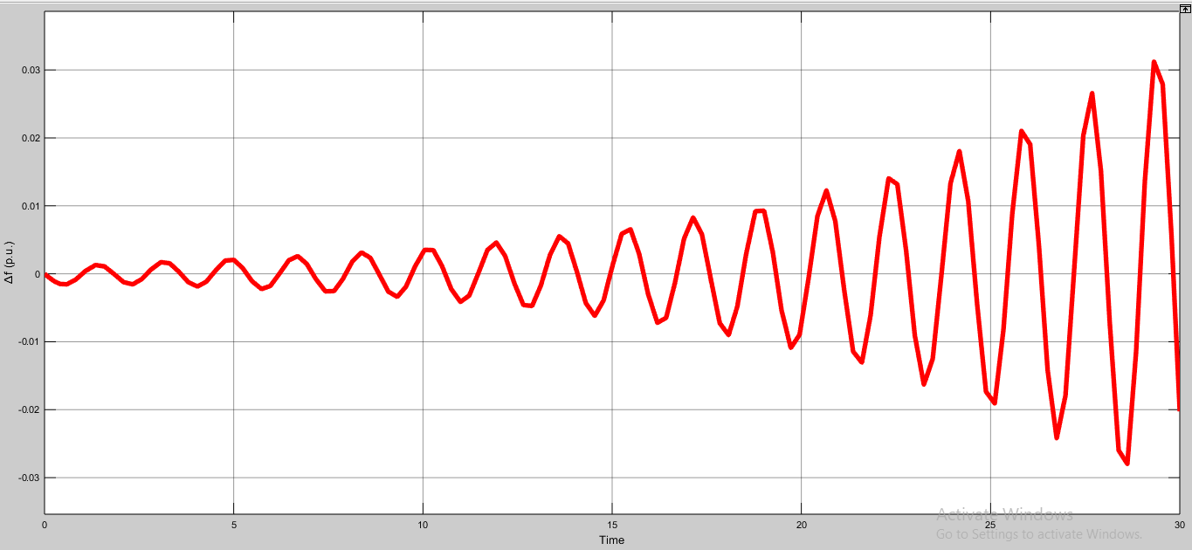
For Time delay=0.5s α₀=1 α₁=0 K_{p}=16 K_{i}=6 (unstable)

Slide 29
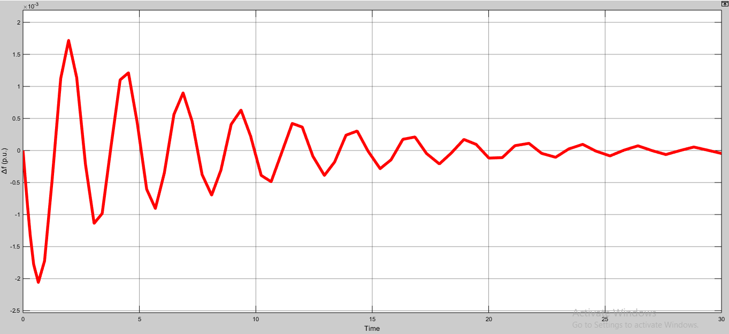
For Time delay=0.5s α₀=1 α₁=0 K_{p}=8 K_{i}=5.4 (marginally stable)

Slide 30
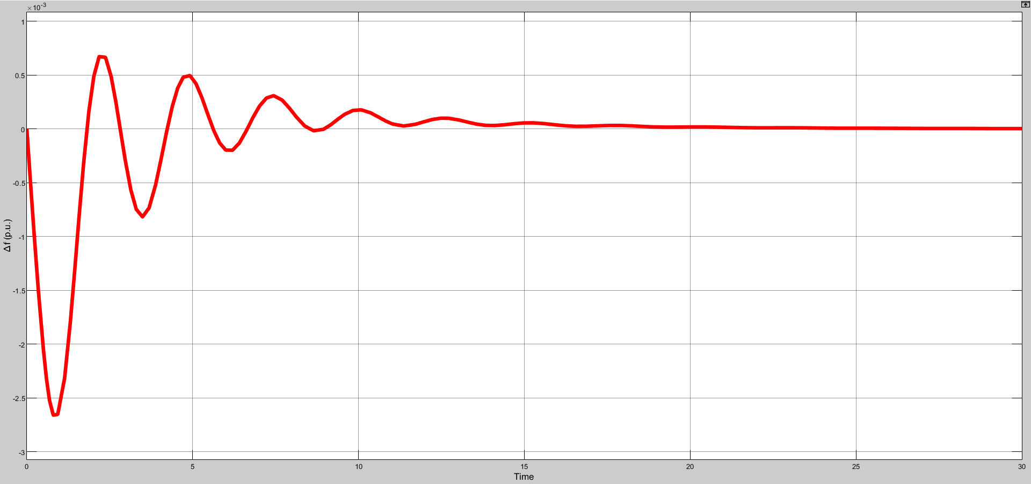
For Time delay=0.5s α₀=0.9 α₁=0.1 K_{p}=4 K_{i}=1 (stable)

Slide 31
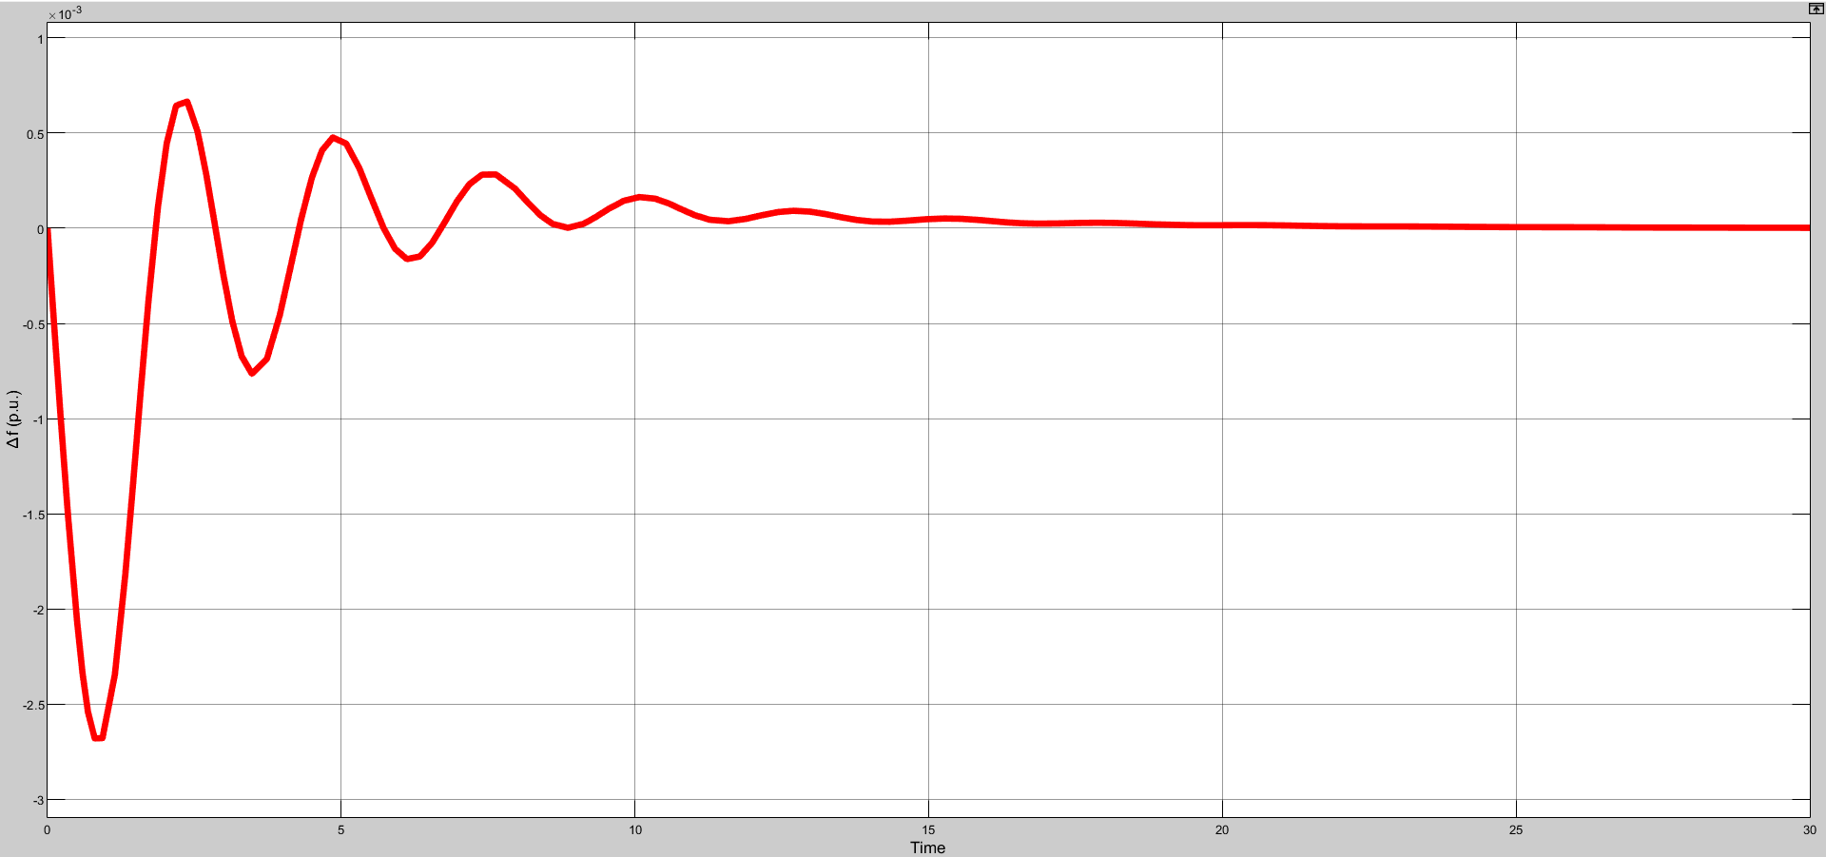
For Time delay=0.5s α₀=0.9 α₁=0.1 K_{p}=3.9 K_{i}=1
(marginally stable)

Slide 32
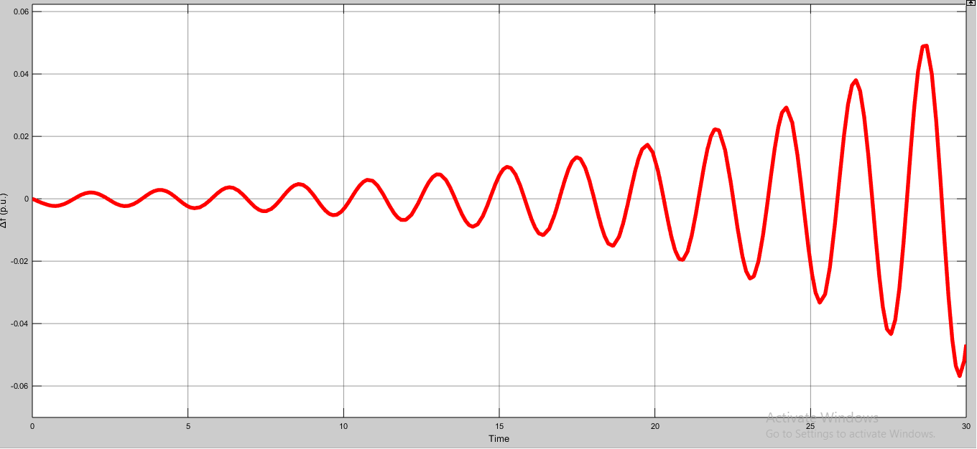
Time delay=0.5s α₀=0.9 α₁=0.1 K_{p}=6 K_{i}=3 ( unstable)

Slide 33
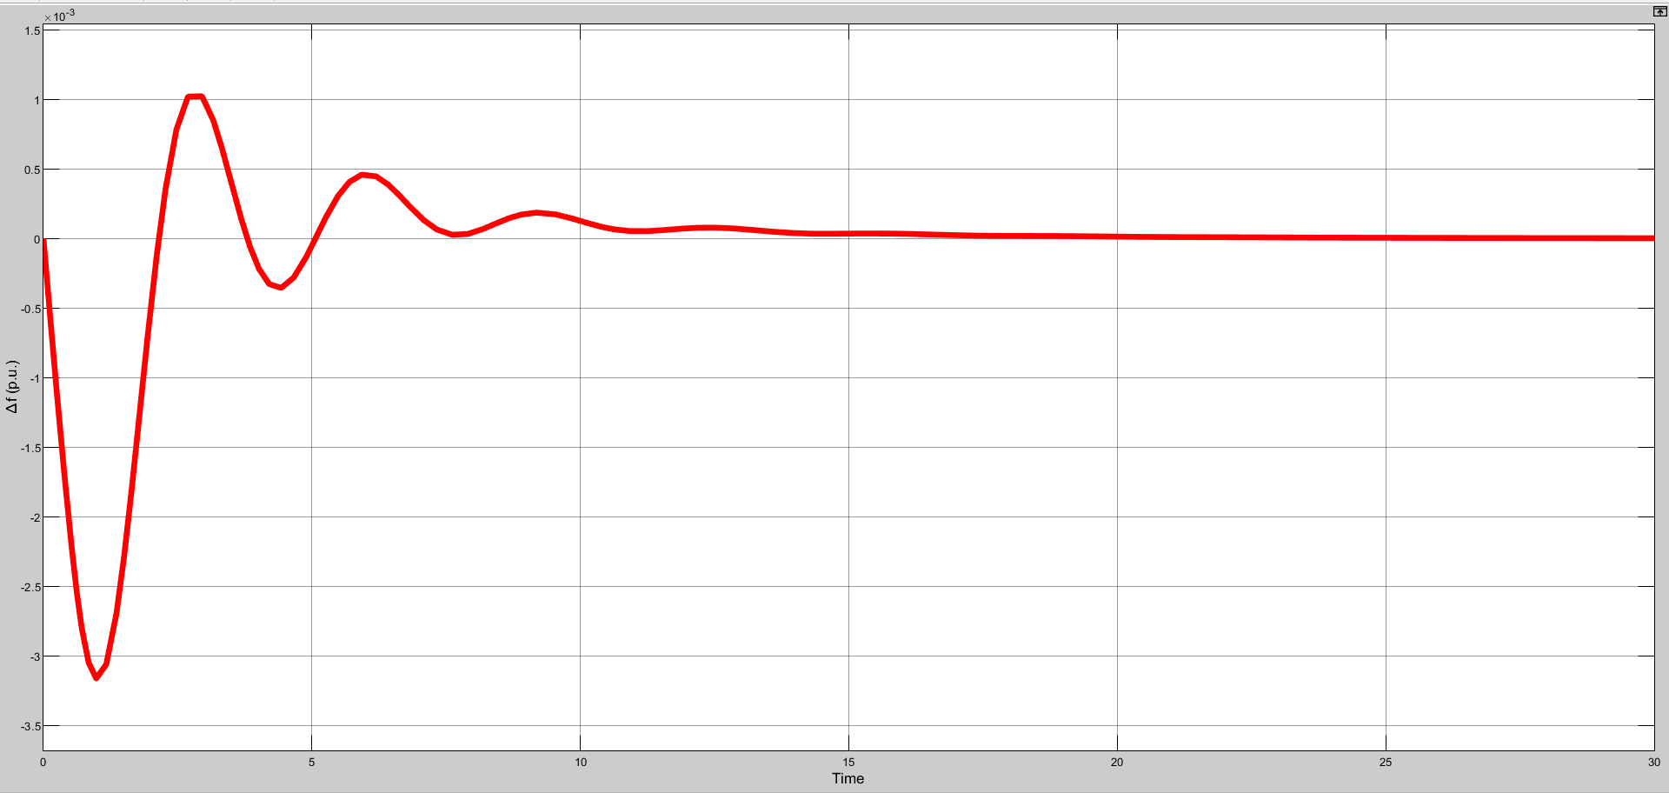
Time delay=0.5s α₀=0.8 α₁=0.2 K_{p}=2 K_{i}=1 (stable)

Slide 34
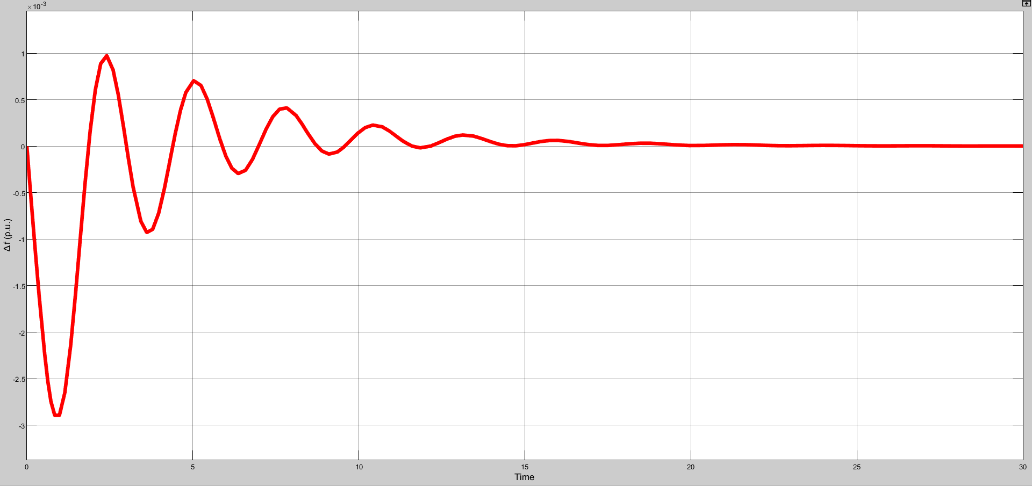
Time delay=0.5s α₀=0.8 α₁=0.2 K_{p}=2.7 K_{i}=1 (marginally stable)

Slide 35
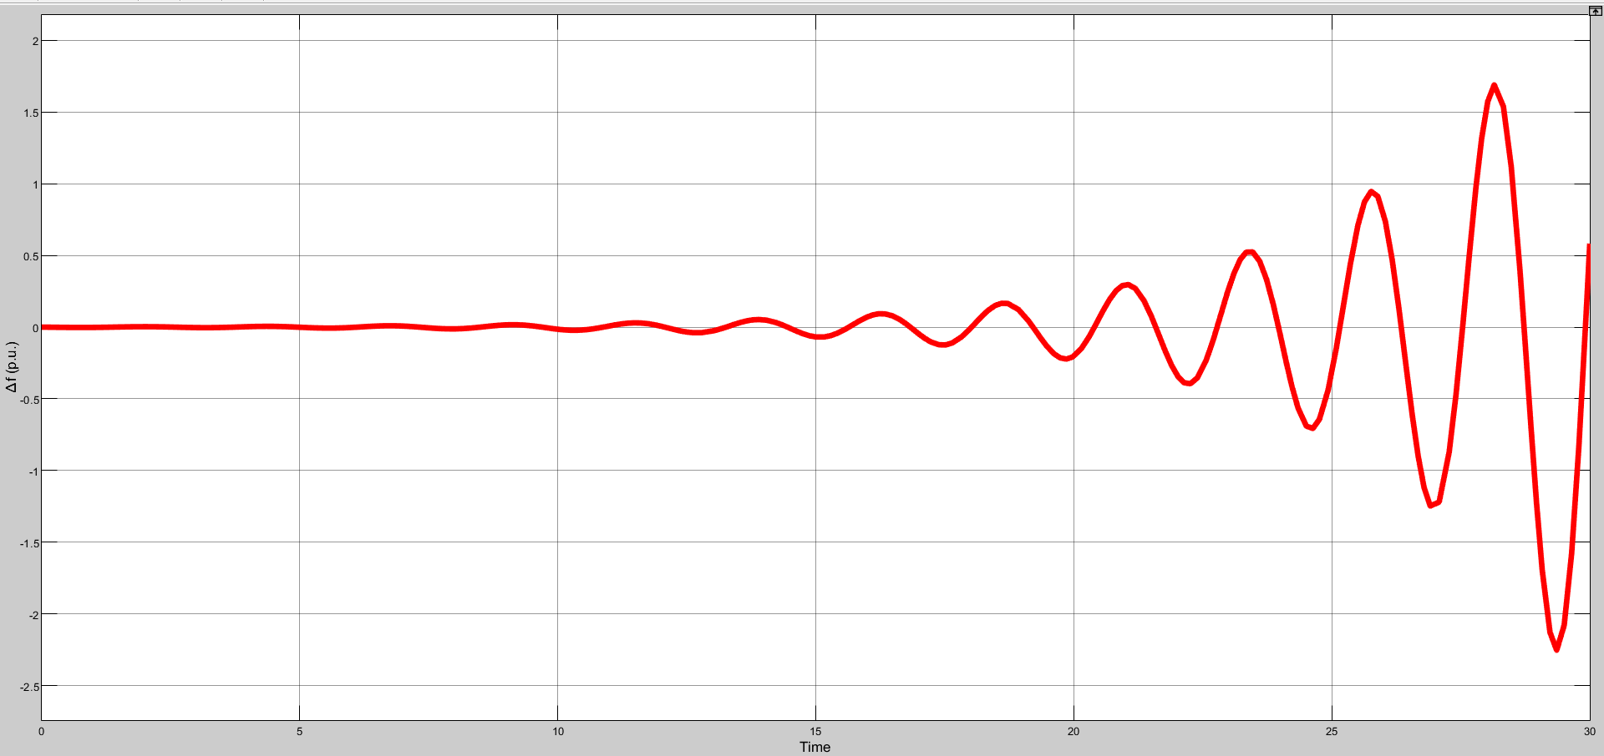
Time delay=0.5s α₀=0.8 α₁=0.2 K_{p}=4 K_{i}=3 (unstable)

Slide 36
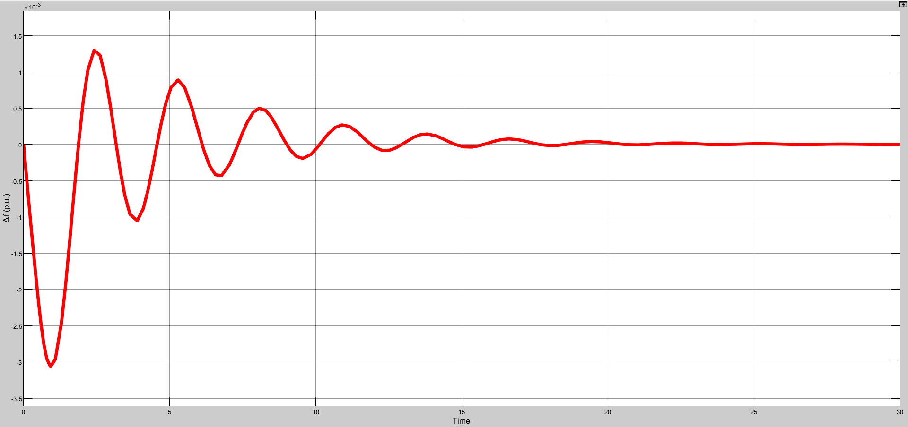
Time delay=0.5s α₀=0.7 α₁=0.3 K_{p}=1 K_{i}=1 (stable)

Slide 37
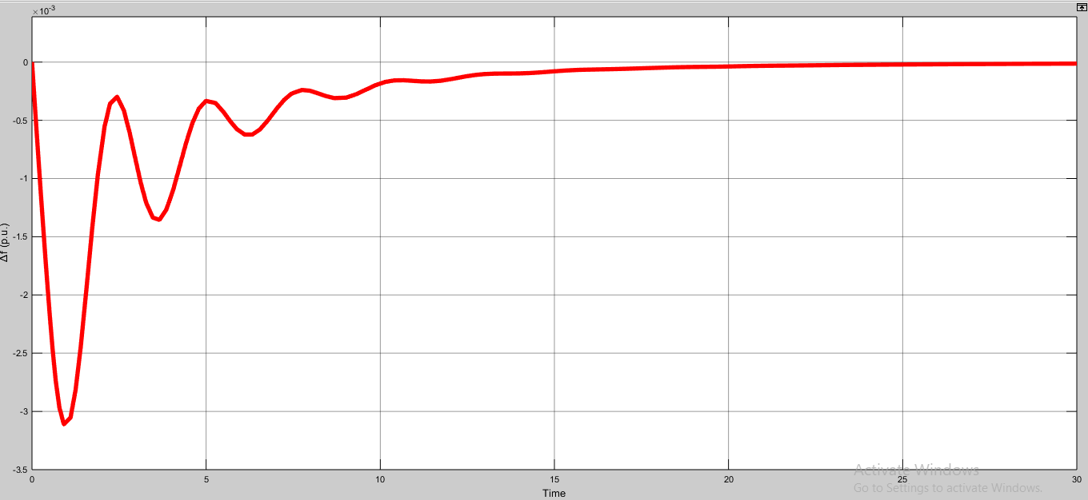
Time delay=0.5s α₀=0.7 α₁=0.3 K_{p}=2 K_{i}=0.1 (marginally stable)

Slide 38
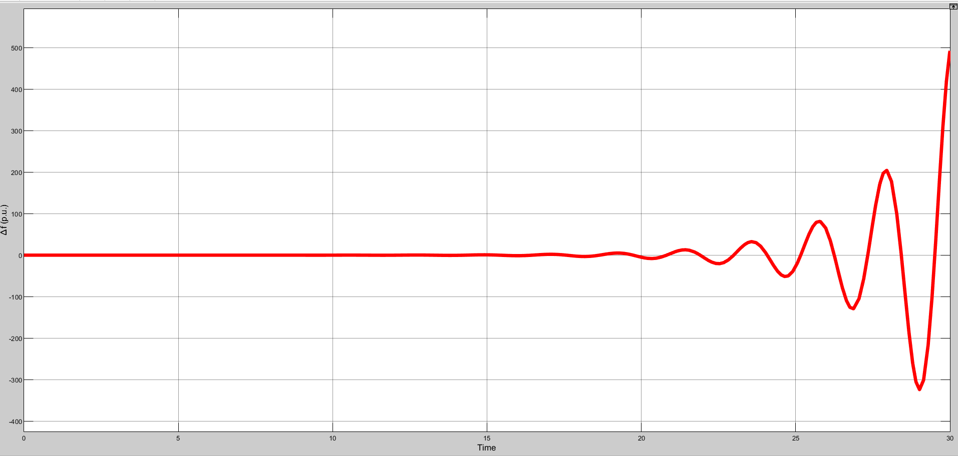
Time delay=0.5s α₀=0.7 α₁=0.3 K_{p}=4 K_{i}=2 (unstable)

Slide 39
CONCLUSION:
In this project a single area LFC system integrated with EV aggregator over a communication network is considered for stability analysis.
The delay-dependent stabilization problem is done to compute a feasible region in PI controller parametric space for a known network delay.
The simulation studies are done to validate the analytics results.

Slide 40
BASE PAPER AND REFERENCES:
Ausnain Naveed, Sahin Sonmez and Saffet Ayasun, ‘Impact of Electric Vehicle Aggregator with Communication Time Delay on Stability Regions and Stability Delay Margins in Load Frequency Control System,’ Journal of Modern Power Systems and Clean Energy, In Press. DOI: 10.35833/MPCE.2019.000244, 2020, Springer. (BASE PAPER)
Hakan Gunduz, Sahin Sonmez and Saffet Ayasun, ‘Impact of Electric Vehicles Aggregator on the Stability Region Micro-Grid System with Communication Time Delay,’ 2019 IEEE Milan Power Tech.
Vijay P. Singh, Nand Kishor, and Paulson Samuel, ‘Communication Time Delay Estimation for Load Frequency Control in Two Area Power Systems,’ Ad Hoc Networks, Vol. 41, No. 1, pp. 69-85, May 2016.
Ausnain Naveed, Sahin Sonmez and Saffet Ayasun, ‘Stability Regions in the Parameter Space for LFC System with EV Aggregator and Incommensurate Time Delays,’ 1st IEEE Global Power Energy and Communication Conference (GPECOM 2019), June 12-15, 2019, Cappadocia, Turkey.
Han, Y., Zhang, K., Hong, L., Coelho, E. A. A., and Guerrero, J. M, ‘MAS-based Distributed Coordinated Control and Optimization in Microgrid and Microgrid Clusters: A Comprehensive Overview.’ IEEE Transactions on Power Electronics, Vol. 33, No. 8, pp. 6488-6508, 2018.

Slide 41
6) H. Luo, I. A. Hiskens and Z. Hu, ‘Stability Analysis of Load Frequency Control Systems With Sampling and Transmission Delay,’ IEEE Transactions on Power Systems, Vol. 35, No. 5, pp. 3603-3615, Sept. 2020
7) K. S. Ko and D. K. Sung, ‘The Effect of EV Aggregators With Time-Varying Delays on the Stability of a Load Frequency Control System,’ IEEE Transactions on Power Systems, Vol. 33, No. 1, pp. 669-680, Jan. 2018
8) Deniz Katipoglu, Sahin Sonmez and Saffet Ayasun, ‘Stability Delay Margin Computation of Load Frequency Control System with Demand Response,’ 1st IEEE Global Power Energy and Communication Conference (GPECOM 2019), June 12-15, 2019, Cappadocia, Turkey.

Slide 42
THANK YOU!!!

